Slide 1
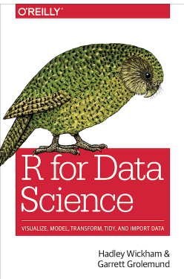
Chapters 7 Exploratory Data Analysis – Pt 2 Follow along here: https://r4ds.had.co.nz/exploratory-data-analysis.html
Source:https://r4ds.had.co.nz/

Slide 2
7.0 – 7.8 Exploratory Data Analysis
Missing Values
If you have unusual values in your data set, but you want to keep working, you have two options:
Drop the entire row with the strange values.
Replace the unusual values with missing values.

Slide 3
7.0 – 7.8 Exploratory Data Analysis
Missing Values
Drop the entire row with the strange values.
diamonds2 <- diamonds %>% filter(between(y, 3, 20))
This might not be the best option; just because one measurement is invalid, it doesn’t mean that all of them are invalid.
And if the data isn’t of very good quality, you might wind up dropping a lot of data.

Slide 4
7.0 – 7.8 Exploratory Data Analysis
Missing Values
A better option might be to replace the unusual values with missing values.
The easiest way to do this is to use mutate() to replace the variable with a modified copy.
You can use the ifelse() function to replace unusual values with NA:
diamonds2 <- diamonds %>%
mutate(y = ifelse(y <3 | y > 20, NA, y))

Slide 5
7.0 – 7.8 Exploratory Data Analysis
Missing Values
ifelse() has three arguments:
The first argument test should be a logical vector.
The result will contain the value of the second argument, yes, when the test is TRUE
And the value of the third argument no, when it is FALSE.
You can also use dplyr::case_when()
This is particularly useful inside mutate when you want to create a new variable that relies on a complex combination of existing variables.

Slide 6
7.0 – 7.8 Exploratory Data Analysis
Missing Values
Like R, ggplot2 subscribes to the philosophy that missing values should never silently go missing.
It’s not obvious where you should plot missing values, so ggplot2 doesn’t include them in the plot, but it does warn that they’ve been removed:

Slide 7
7.0 – 7.8 Exploratory Data Analysis
Missing Values
ggplot(data = diamonds2, mapping = aes(x = x, y = y)) + geom_point()
#> Warning: Removed 9 rows containing missing values (geom_point)

Slide 8
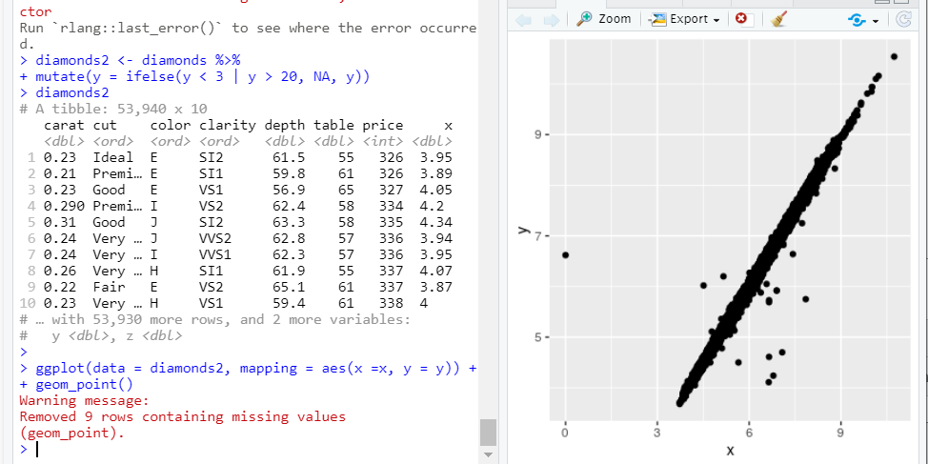
7.0 – 7.8 Exploratory Data Analysis
Missing Values

Slide 9
7.0 – 7.8 Exploratory Data Analysis
Missing Values
To suppress that warning, set na.rm = TRUE:
ggplot(data = diamonds2, mapping = aes(x = x, y =y)) + geom_point(na.rm = TRUE)

Slide 10
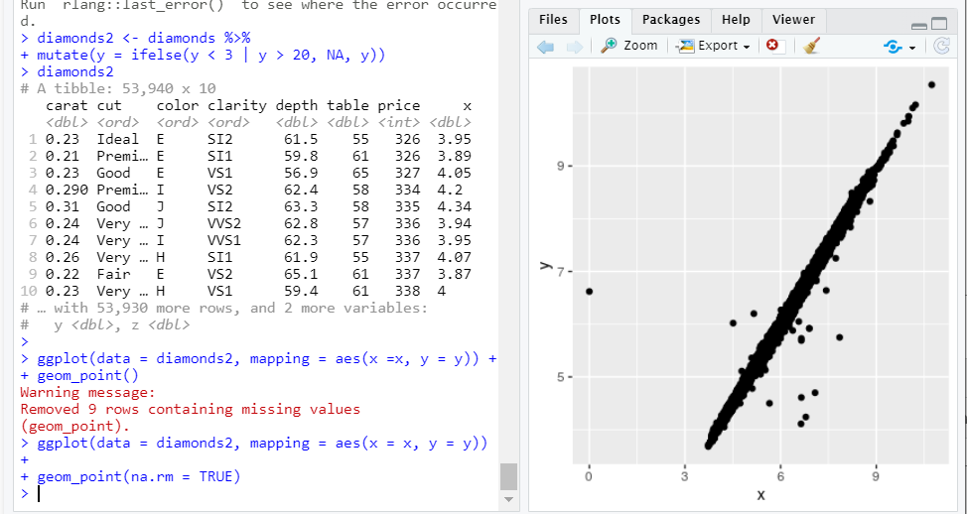
7.0 – 7.8 Exploratory Data Analysis
Missing Values

Slide 11
7.0 – 7.8 Exploratory Data Analysis
Missing Values
Other times you want to understand what makes observations with missing values different to observations with recorded values.
In nycflights13::flights missingvalues in the dep_time variable indicate that the flight was cancelled.
You might want to compare the scheduled departure times for cancelled and non-cancelled times.
You can do this by making a new variable with is.na

Slide 12
7.0 – 7.8 Exploratory Data Analysis
Missing Values
nycflights13::flights %>% mutate( cancelled = is.na(dep_time), sched_hour = sched_dep_time %/% 100, sched_min = sched_dep_time %% 100, sched_dep_time = sched_hour + sched_min / 60 ) %>% ggplot(mapping = aes(sched_dep_time)) + geom_freqpoly(mapping = aes(color = canceled, binwidth = ¼)

Slide 13
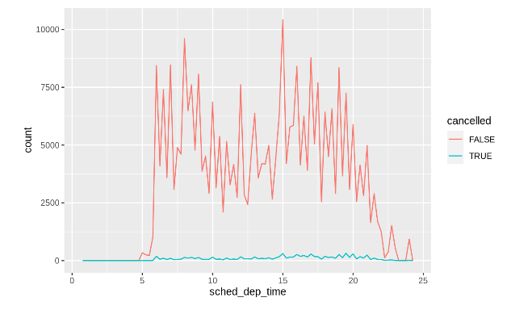
7.0 – 7.8 Exploratory Data Analysis
Missing Values

Slide 14
7.0 – 7.8 Exploratory Data Analysis
Covariation
Variation describes the behavior within a variable.
Covariation describes the behavior between variables.
Covariation is the tendency for the values of two or more variables to vary together in a related way.
The best way to spot covariation is to visualize the relationship between two or more variables.
How you do that should again depend on the type of variables involved.

Slide 15
7.0 – 7.8 Exploratory Data Analysis
Covariation
It’s common to want to explore the distribution of a continuous variable broken down by a categorical variable.
The default appearance of geom_freqpoly is not that useful for that sort of comparison, because the height is given by the count.
That means if one of the groups is much smaller than the others, it’s hard to see the differences in shape.

Slide 16
7.0 – 7.8 Exploratory Data Analysis
Covariation
How the price of a diamond varies with its quality:
ggplot(data = diamonds, mapping = aes(x = price) )+ geom_freqpoly(mapping = aes(color = cut), binwidth = 500)

Slide 17
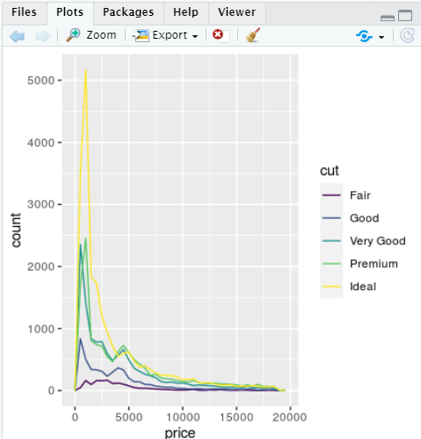
7.0 – 7.8 Exploratory Data Analysis
Covariation

Slide 18
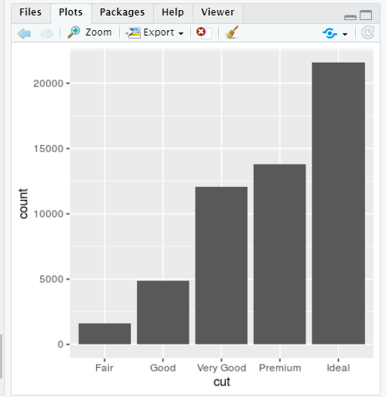
7.0 – 7.8 Exploratory Data Analysis
Covariation
It’s hard to see the difference in distribution because the overall counts differ so much:
ggplot(diamonds) + geom_bar(mapping = aes(x = cut))

Slide 19
7.0 – 7.8 Exploratory Data Analysis
Covariation
To make the comparison easier let’s swap what is displayed on the y-axis.
Instead of displaying count, we’ll display density, which is the count standardized so that the area under each frequency polygon is one.
ggplot(data = diamonds, mapping = aes(x= price, y = ..density..) + geom_freqpoly(mapping = aes(color = cut), binwidth = 500)

Slide 20
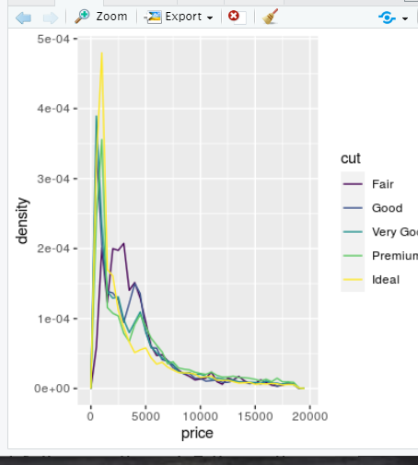
7.0 – 7.8 Exploratory Data Analysis
Covariation
Old
New

Slide 21
7.0 – 7.8 Exploratory Data Analysis
Covariation
Another alternative to display the distribution of a continuous variable broken down by a categorical variable is the boxplot.
A boxplot is a type of visual shorthand for a distribution of values that is popular among statisticians. Each boxplot consists of:
A box that stretches from the 25th percentile of the distribution to the 75th percentile, a distance known as the interquartile range (IQR). In the middle of the box is a line that displays the median, i.e. 50th percentile, of the distribution. These three lines give you a sense of the spread of the distribution and whether or not the distribution is symmetric about the median or skewed to one side.

Slide 22
7.0 – 7.8 Exploratory Data Analysis
Covariation
Visual points that display observations that fall more than 1.5 times the IQR from either edge of the box. These outlying points are unusual so are plotted individually.
A line (or whisker) that extends from each end of the box and goes to the farthest non-outlier point in the distribution.

Slide 23
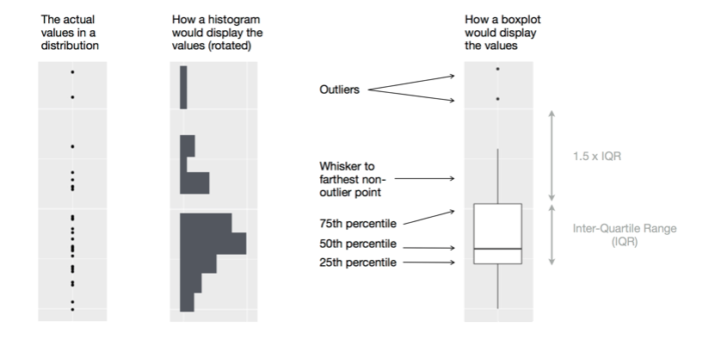
7.0 – 7.8 Exploratory Data Analysis
Covariation

Slide 24
7.0 – 7.8 Exploratory Data Analysis
Covariation
Let’s take a look at the distribution of price by cut using geom_boxplot.
ggplot(data = diamonds, mapping = aes(x = cut, y = price)) + geom_boxplot()

Slide 25
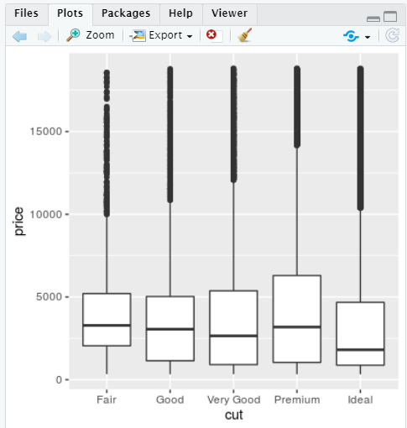
7.0 – 7.8 Exploratory Data Analysis
Covariation

Slide 26
7.0 – 7.8 Exploratory Data Analysis
Covariation
We see much less information about the distribution
But the boxplots are much more compact so we can more easily compare them (and fit more on one plot).
It supports the counterintuitive finding that better quality diamonds are cheaper on average!

Slide 27
7.0 – 7.8 Exploratory Data Analysis
Covariation
cut is an ordered factor: fair is worse than good, which is worse than very good and so on.
Many categorical variables don’t have such an intrinsic order, so you might want to reorder them to make a more informative display.
One way to do that is with the reorder() function

Slide 28
7.0 – 7.8 Exploratory Data Analysis
Covariation
Take the class() variable in the mpg dataset.
You might be interested to know how highway mileage varies across classes:
ggplot(data = mpg, mapping = aes(x = class, y = hwy)) + geom_boxplot()

Slide 29
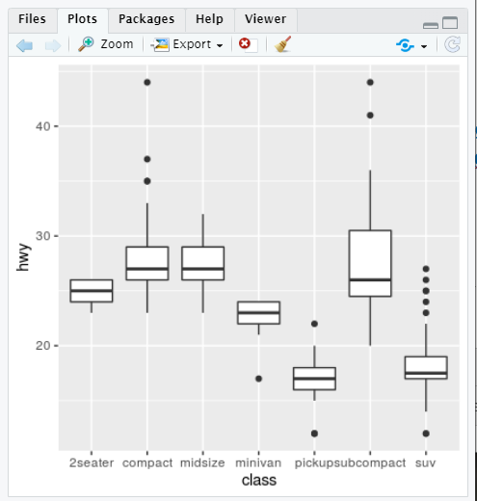
7.0 – 7.8 Exploratory Data Analysis
Covariation

Slide 30
7.0 – 7.8 Exploratory Data Analysis
Covariation
To make the trend easier to see, we can reorder class based on the median value of hwy.
ggplot(data = mpg) + geom_boxplot(mapping = aes(x = reorder(class, hwy, FUN = median), y = hwy))

Slide 31
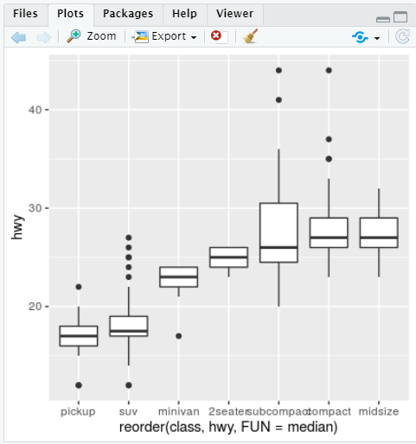
7.0 – 7.8 Exploratory Data Analysis
Covariation

Slide 32
7.0 – 7.8 Exploratory Data Analysis
Covariation
If you have long variable names, geom_boxplot() will work better if you flip it 90°. You can do that with coord_flip().
ggplot(data = mpg) + geom_boxplot(mapping = aes(x = reorder(class, hwy, FUN = median), y = hwy)) + coord_flip()

Slide 33
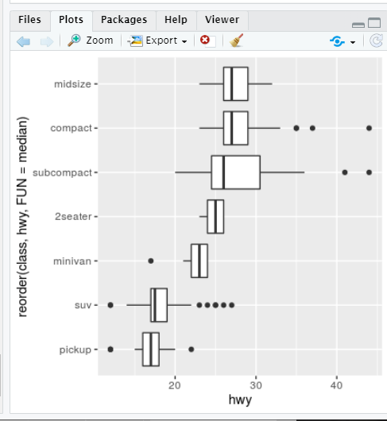
7.0 – 7.8 Exploratory Data Analysis
Covariation

